Slide 1
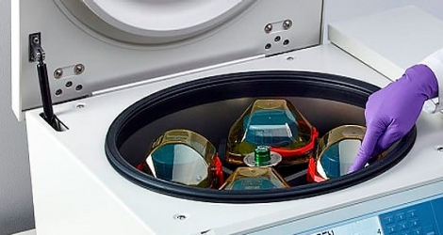
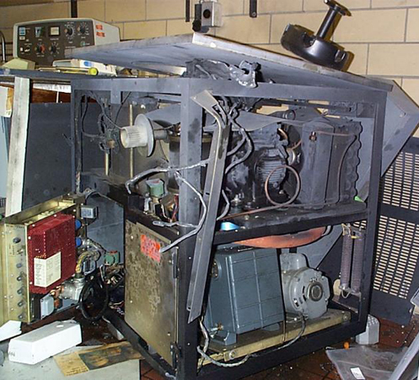
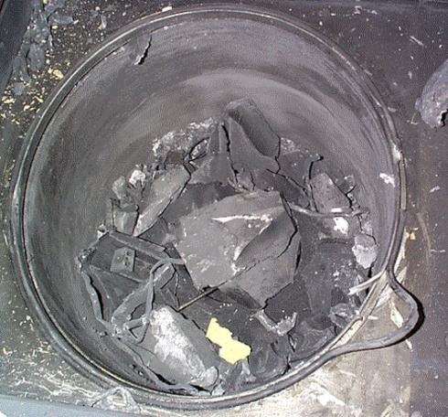
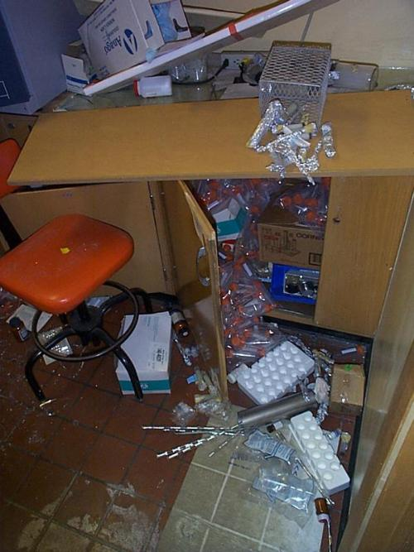
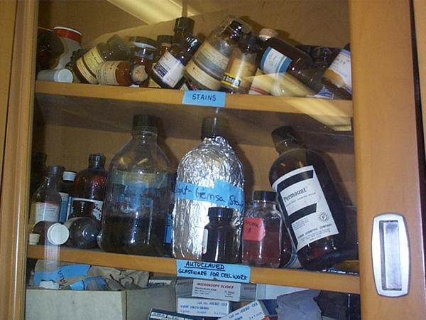
Laboratory Safety Centrifuges
Centrifuges, which operate at high speed, have great potential for injuring users if not operated properly.
Unbalanced centrifuge rotors can result in injury or death.
Sample container breakage can release aerosols that are harmful if inhaled.
December 16, 1998 Cornell
www.osha.gov
https://www.chem.purdue.edu/chemsafety/news-and-stories/CentrifugeDamages.php

Slide 2
Use matched sets of tubes, buckets and other equipment.
Inspect tubes or containers for cracks or flaws before using them.
Always use safety centrifuge cups to contain potential spills and prevent aerosols.
Ensure that the rotor is properly seated on the drive shaft.
Do not exceed the rotor’s maximum run speed.
ALWAYS determine the maximum allowable speed for the density gradient of the material (cesium chloride, sugars)
When centrifuging infectious materials, wait 10 minutes after the rotor comes to a complete stop before opening the lid.
https://www.safety.rochester.edu/ih/notices/centrifugeincident.pdf
2

