Slide 1
Vacuum Pump Safety

Slide 2
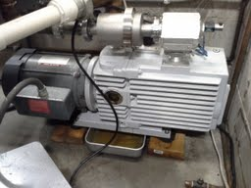
Physical and Chemical Hazards
Always vent pump exhaust
Keep pump away from flammable chemicals or combustible material
Do not place a pump in an enclosed area
Unventilated areas will cause heat and exhaust build up

Slide 3
Physical and Chemical Hazards
Always close the valve between the pump and vacuum vessel before shutting off the pump
This avoids oil from being sucked into the vacuum vessel
Have a pan to catch oil drips from under the pump
Bakeware pans (aluminum or stainless steel) or plastic pans work well

Slide 4
Maintenance
Oil Change: Know how often each pump needs an oil change
Monitor oil levels between changes
Keep Records: Keep a log of the dates on which the oil was changed
Always wear PPE
Dispose of used pump oil as hazardous waste

