Slide 1
Naphthalene

Slide 2
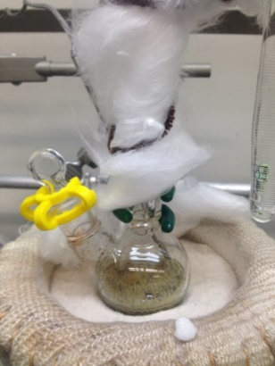
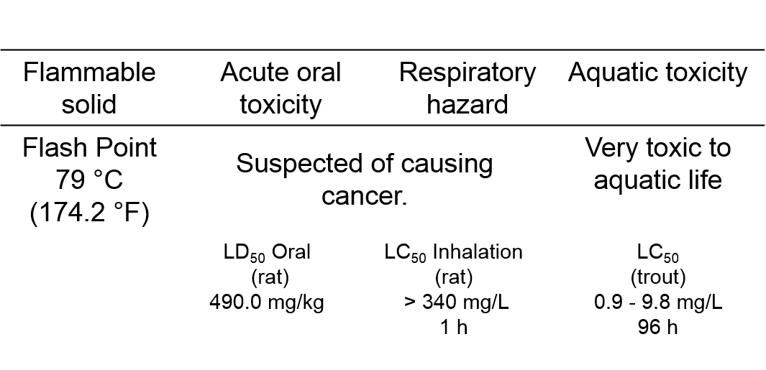
Naphthalene

Slide 3
Naphthalene
Best Practices:
Follow standard laboratory practices
Ensure adequate ventilation and avoid breathing vapors
Handle with gloves to prevent skin contact
Wash skin thoroughly after handling
Store away from heat/sparks in dry well-ventilated place
Avoid release to the environment
Exposure Routes:
inhalation, skin absorption, ingestion, eye contact
Symptoms:
irritation, headache, confusion, nausea, vomiting, abdominal pain, irritated bladder

